Slide 1
Reverse Engineering
Asst. Prof. Karmjitsinh bihola
Centre for Industrial design (open design school)
Gujarat Technological university

Slide 2
Introduction
A systematic methodology for analyzing the design for extracting information of an existing device or system or process, either as an approach to study the design or as a prerequisite for re-design.
The process often involves disassembling something (a mechanical device, electronic component, computer program, or biological, chemical, or organic matter) and analysing its components and workings in detail

Slide 3
Levels of Analysis in RE
System-Wide Analysis
Customer Requirements
Engineering Requirements
Functional Specifications
Prediction of Subsystems and Components
Subsystem Dissection Analysis
Document Disassembly
Define Subsystems
Determine Subsystem Functional Specifications
Determine Subsystem Physical/Mathematical Principles
Individual Component Analysis
Repeat Dissection Steps to Individual Component
Define Component Material Selection and Fabrication Process
Suggest Alternative Designs, Systems, Components, and Materials

Slide 4
Innovation could be possible if-
Material
Technology/Process
Application

Slide 5
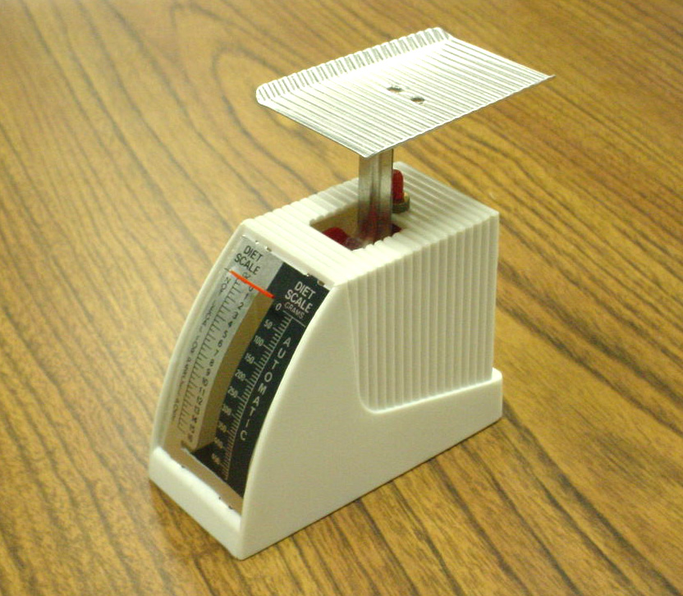
Example: Small Kitchen Scale
The Kitchen Scale is a useful device to measure out small amounts of food that are to be prepared.
There are many people who need to be careful of the quantity of food that they take in.
  Diabetics must be careful of the amount of certain foods that they eat in order to maintain a proper sugar level.
  People on weight loss diets must also be careful with the number of calories that they consume at every meal.
  The Kitchen Scale is a device that can help control the amount of food consumed by an individual

Slide 6
Customer’s Perspective
Engineer’s Perspective
Cost
Appearance
Size
Quality for the price
How sturdy the device is?
Accuracy of the weighing process
Material (Strength)
Mechanisms to be used
Manufacturing process
In relation to the kitchen scale:
Is the riveting process of the plate to the stem adequate?
Are the materials used strong enough to hold one pound of weight?
Does the kitchen scale have any sharp edges that could cause injury?
What mechanism is necessary to give an accurate reading on the scale?

Slide 7
Functional Requirements
The kitchen scale must be able to accommodate 1 pound of food.
The plate must be large enough to hold 1 pound of food.
The stem must be strong enough to support the plate and the food.
The linkage must be designed so that the reading is accurate to the nearest .25 ounce.
The read-out must be easily read.
The design must lend itself for easy cleaning and sanitizing.

Slide 8
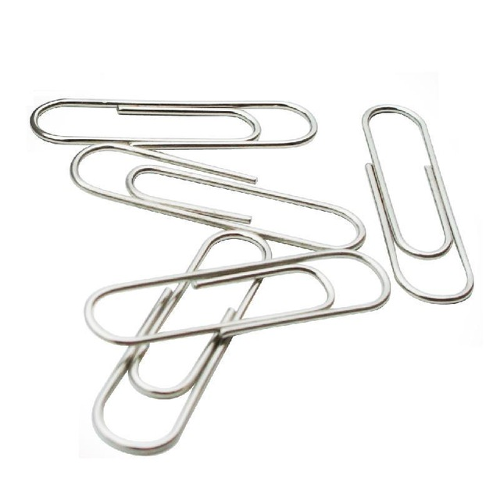
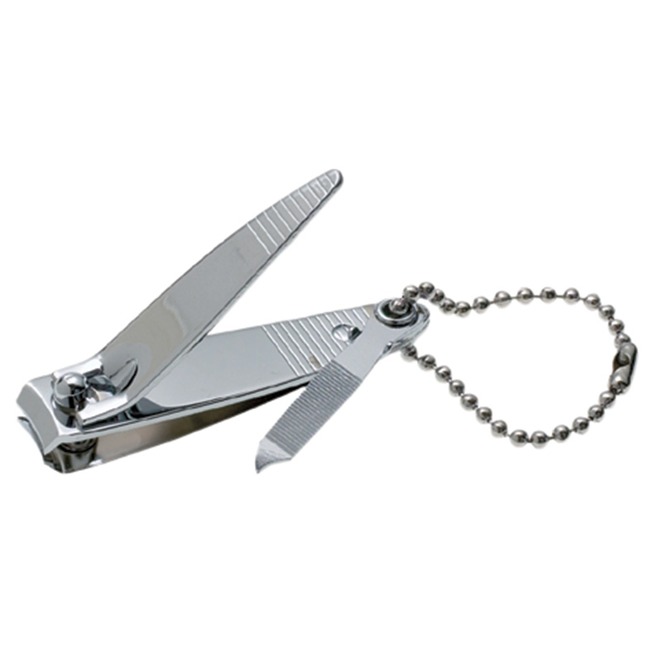
Exercise
Think of new innovative applications, For a paper U clips.
Suggest some improvements in this common design of nail cutter

Slide 9

Hands on
Stapler
List problems associated with stapler
Suggest some modifications then
Use simple questions to trigger creative thinking
(Who?, What?, Where?, When?, Why?, How?)

Slide 10
Approach needs to taken by GTU students for RE in DE - 1B, 4th semester
Students need to select branch specific existing artefact/component for Reverse Engineering and modify/redesign it as per the User’s needs using Design Thinking.
There are three basic objectives of introducing RE: (1) Students will learn some basic concept from their branch and relate all stages/phases of Design Engineering with their regular core subjects of particular branch in current or further semester/s - as one of the key objectives of Design Engineering subject is to absorb Design Thinking approach into core engineering subject for practical learning (2) they will use Design Thinking process again to refine their learning. (3) Some of the products/components would be refined for better use by industry or society by students projects.
In this module also whole Design Thinking process will be used by students, but more emphasis on Ideation and initial Product Development phase.

Slide 11
Resources:
http://goo.gl/MzMun5
http://en.wikipedia.org/wiki/Reverse_engineering
http://www.asme.org/kb/news---articles/articles/computational-methods---modeling/the-rise-of-reverse-engineering
R. Schenker, Novel combination of RE & RP in medicine, South African Journal of Science, 95, August 1999

Slide 12
Thank you
Should you have any query, kindly write us at: design@gtu.edu.in
For more information, kindly visit us at: http://de.gtu.ac.in/

